Slide 1
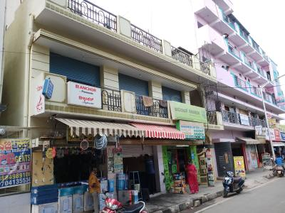
Analysis of a fast food shop – Weather to continue or discontinue its operations

Slide 2
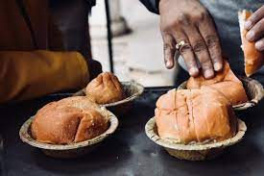
Objective
To find reasons why a person, who has started a fast food shop at the BTM Layout ,Which is one of the most popular residential and commercial places in Bengaluru, who was profitable for first 3 month ,has started occurring losses from 4th month and giving the solutions accordingly .

Slide 3

Sales and expense data
Sales Data
Month | Veg Briyani | Non Veg Briyani | Egg Bhujia | Omlet | Chicken Kabab | Chicken Patties | Mutton Kebab | French Fries | Total sales | Profit
1 | 2200 | 11500 | 11500 | 12800 | 16500 | 21000 | 19000 | 5500 | 100000 | 33340
 | 0.022 | 0.115 | 0.115 | 0.128 | 0.165 | 0.21 | 0.19 | 0.055
2 | no more | 22000 | 19000 | 16000 | 14000 | 20000 | 9000 | no more | 100000 | 33340
 |  | 0.22 | 0.19 | 0.16 | 0.14 | 0.2 | 0.09 | #VALUE!
3 | no more | 24000 | 17000 | 14000 | 16000 | 15000 | 14000 | no more | 100000 | 33320
 |  | 0.24 | 0.17 | 0.14 | 0.16 | 0.15 | 0.14 | #VALUE!
4 | no more | 12500 | 9100 | 7500 | 9000 | 7500 | 7000 | no more | 52600 | -14000
 |  | 0.237642586 | 0.1730038 | 0.14258555 | 0.171102662 | 0.142585551 | 0.133079848
5 | no more | 9100 | 9000 | 12500 | 7500 | 7000 | 7500 | no more | 52600 | -14000
 |  | 0.173003802 | 0.17110266 | 0.23764259 | 0.142585551 | 0.133079848 | 0.142585551

Slide 4
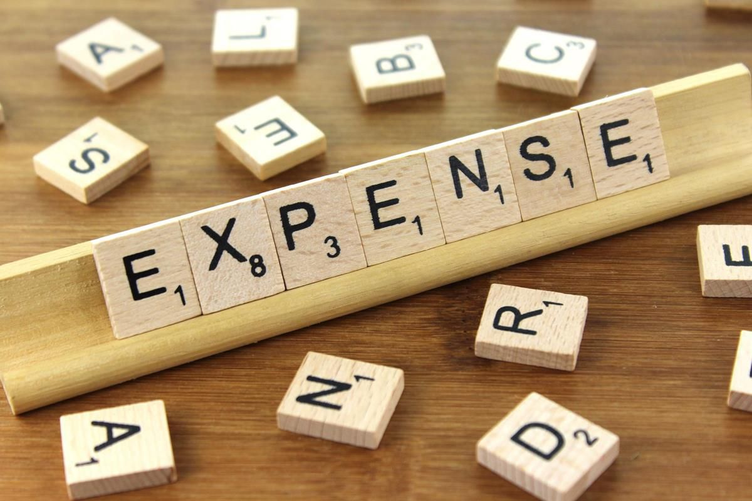
Expenses
month | Raw Material | Rent | electricity | employee | gas | oil | miscellinous exp( decoration , pacaging, cleaning) | Total
1 | 24600 | 14000 | 1000 | 7000 | 8000 | 9000 | 3000 | 66600
2 | 24600 | 14000 | 1000 | 7000 | 8000 | 9000 | 3000 | 66600
3 | 24600 | 14000 | 1000 | 7000 | 8000 | 9000 | 3000 | 66600
4 | 24600 | 14000 | 1000 | 7000 | 8000 | 9000 | 3000 | 66600
5 | 24600 | 14000 | 1000 | 7000 | 8000 | 9000 | 3000 | 66600

Slide 5
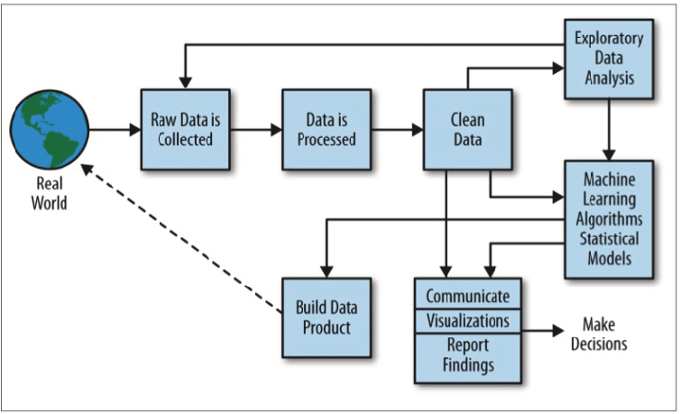
Problem Statement & Objective
Understanding the factors That can affect the sales and help to again get back to the same profits that he was making in first 3 months .
The Man is very lazy in working hard and also very poor in any other investment.
-Achieve Break Even Point for next month
-Increase the sales to earn profit =>33340

Slide 6
Solution Description
Owner has to work on himself
Do survey to identify what people prefer in his locality
Increase speed of services
Social media promotion
List on Websites like Zomato , Swiggy . Etc
Offer Discounts
Use Environmental Friendly things .

Slide 7
THANK YOU
- Pranjal Arora

